Slide 1
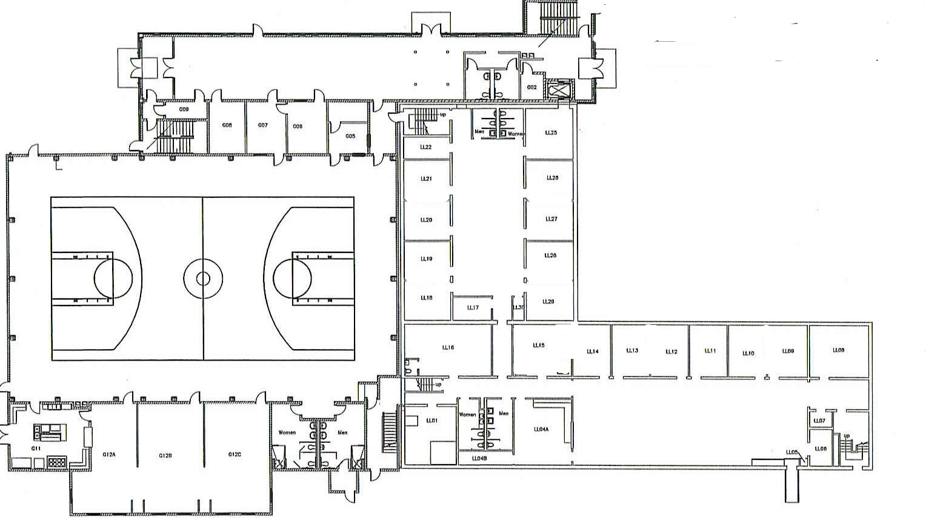







West Broadway Baptist Church
8420 Six Mile Ln
502-491-1920
HISTORIC DRIVE
D-2
D-3
Main Entrance
A-1
N
C-4
FIRE SYSTEM REMOTE PANEL
A-2
NARTHEX
D-1
C-3
G09
ELEVATOR
G08
G07
G06
LL25
G05
LL21
LL21
LOWER LEVEL & GROUND FLOOR
MAIN WATER SHUTOFF
LL26
MAIN SPRINKLER
SYSTEM SHUTOFF
LL20
LL27
LL19
LL28
FIRE SYSTEM MAIN PANEL
RAINBOW
AREA
LL18
LL21
LL29
LL16
LL15
LL14
LL13
LL12
LL11
LL10
LL09
LL08
C-2
SIX MILE LANE
KITCHEN
G12A
G12B
G12C
LL01
LL04A
OLD FELLOWSHIP HALL
OLD
KITCHEN
MAIN ELECTRICAL PANEL
MAIN
GAS
SHUTOFF
NEW FELLOWSHIP HALL
B-1
ELECTRICAL PANEL(S)
B-2
C-1
B-4
WATER SHUTOFF
SEWER LIFT STATION
FIRST AID KIT

Slide 2
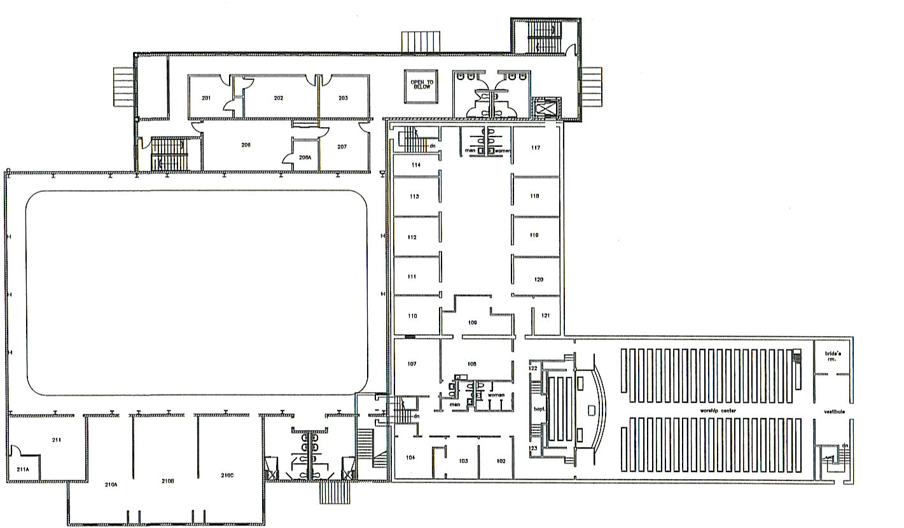
HISTORIC DRIVE
N
2nd FLOOR NARTHEX
1ST & 2ND FLOORS
201
202
203
206
206A
207
ELEVATOR
ELECTRICAL PANEL(S)
OLD
CHOIR
ROOM
WATER SHUTOFF
SIX MILE LANE
FIRST AID KIT
SANCTUARY
211
210A
210B
210C
A-3
211A
B-1
B-4
B-3
SECURITY SYSTEM MAIN PANEL

